Slide 1
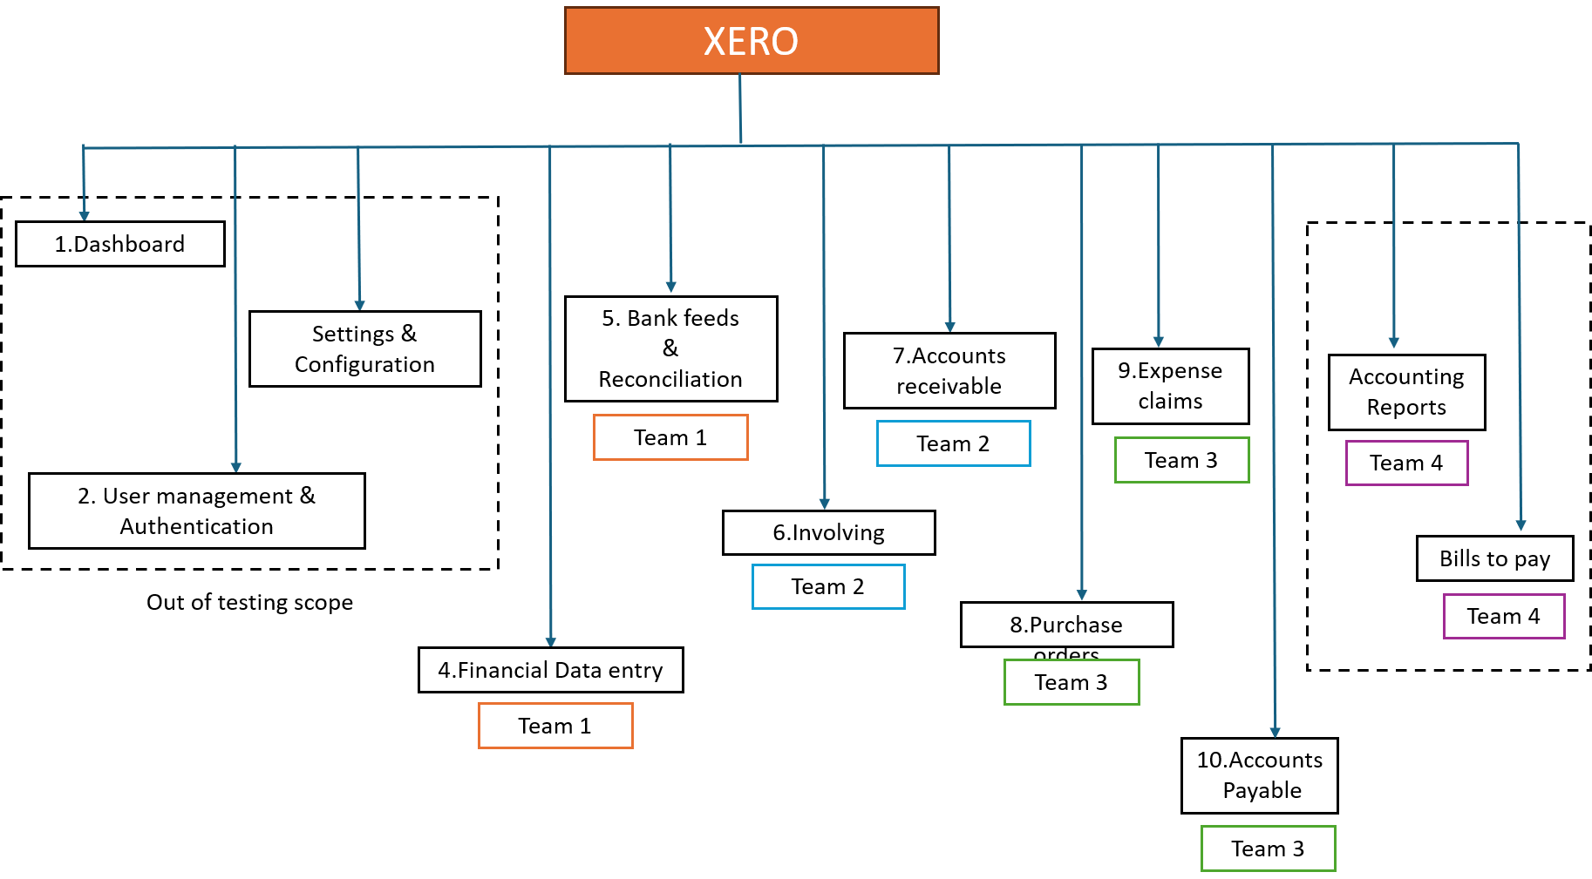
Functional Decomposition Diagram
8.Purchase Orders
Notes:
Functional decomposition diagram

Slide 2
